Slide 1
College of Health Professions Promotion and/or Tenure Portfolio Preparation Workshop
CHP P&T Committee Members:
Tony Baker
Theresa Gramlich
Tiffany Huitt
Josh Phelps
Katy Warren
Mark Zoeller

Slide 2
This section provides examples to help communicate accomplishments in service in accordance with CHP P&T guidelines.
Service Folder
Service is a responsibility of all CHP faculty and should:
Be related to faculty’s profession & area of expertise
Enhance function & development of organization, profession, or community

Slide 3
Levels of Service
Program or Department
College of Health Professions
University of Arkansas for Medical Sciences
State of Arkansas or Local/Regional Area
National or International

Slide 4
Service – Program Or Department
Levels of Service
Program
Student admissions committee
Faculty recruitment committee
Student academic performance committee
Department
Promotion and tenure committee
Department action team

Slide 5
Service - College Level
Levels of Service
CHP Committees
Alumni Relations & College Advancement
Curriculum
Diversity
Faculty Development & Services
Grievance Pool
Promotion & Tenure
Scholarship
Special committees as assigned

Slide 6
Service – University Level
Levels of Service
Numerous opportunities available campus-wide
Academic Senate Council
IPE Committees
Chancellor Committees
Library Advisory Committee
Radiation Safety Committee
And many, many more….

Slide 7
Service – State & Local Level
Levels of Service
Advisory board
Professional society
Editor or author of professional publication
Consultant

Slide 8
Service – National Or International Level
Levels of Service
Accreditation agency
Advisory board
Professional society
Professional society editorial board
Professional licensure/certification organization
Federal government consultant

Slide 9
Examples of Service Activities
A list of examples (see next slide) that may be used to demonstrate excellence (or significant achievement) in service is located in the Service folder in the CHP P&T Database. If service is an area where you are indicating you have achieved excellence, your narrative should be directed toward describing how your accomplishments contributed to demonstrating excellence, only, and not significant achievement.
The list of examples may help you to identify your areas of strength.
Within your narrative, do not make the P&T committee hunt for your evidence. State it clearly with detailed descriptions, dates, evidence, etc.
In all instances, quality and impact of service are key considerations in promotion and tenure.

Slide 10
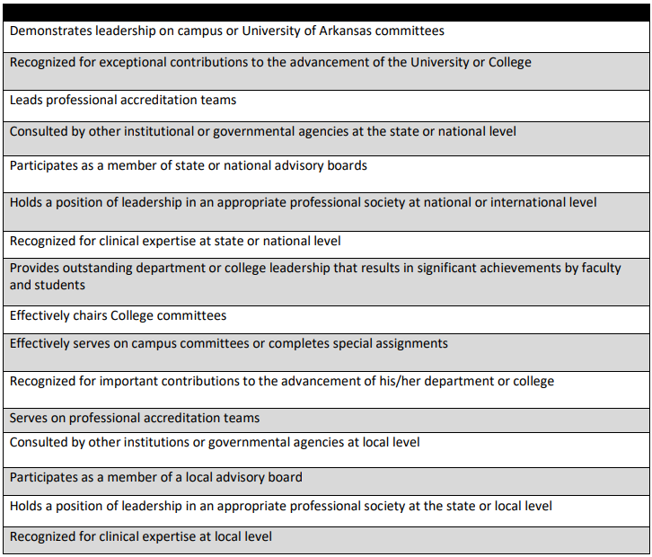
Service - Demonstrating Excellence or Significant Achievement
Examples (not an exhaustive list) of accomplishments in service.
May be used to demonstrate excellence or significant achievement.
Narrative should explicitly describe how these (and any other) accomplishments contribute to demonstrating either excellence or significant achievement.

Slide 11
Service Narrative
Use examples from the list in the Service folder (or other service-related accomplishments) to guide your service narrative.
Use headings within your narrative to depict what’s coming in that part of the narrative.
The percent of your time dedicated to service should be stated in your service narrative.
Percent effort is related to your assigned workload.
The larger your percent effort/workload dedicated to service, the more accomplishments you should have toward demonstrating excellence (or significant achievement).

Slide 12
Service Narrative
One of the more challenging areas of the P&T process to write about!
Should describe each of your service activities in detail
Level of service
How much time spent in this activity
Need to explain the impact (“so what?” factor) of your service
What positive changes occurred as a result of your service?

Slide 13
Example of Service Activity Narrative – University Level
Service Narrative
Effectively Serves on Campus Committees or Completes Special Assignments (this would be the heading in the narrative)
A large part of my service involvement in the 20##-20## academic year was centered around the 12th Street Health and Wellness Clinic. For the first time in February 20##, diagnostic ultrasound examinations were performed on patients at Women’s Health Night. Since February, we have imaged a second Women’s Health Night and plan to provide imaging to patients the second Thursday of each month. The goal for this project is to meet the needs of community members who are largely underserved, as well as provide a rich, interprofessional learning environment for students. Since imaging began at 12th Street, I have worked with medical students, physician assistant students, and both graduate and undergraduate nursing students.
Even better would have been to include in the narrative specific details about what this individual contributed to the events [specific role(s) and responsibilities], and details specifying “large part”; for example, tying time spent to workload allotment. Consider an evaluative piece; for example, survey students to measure their knowledge, or skills learned through the service that was provided – getting at the impact related to the service.

Slide 14
Examples of Service Activity Narrative – National Level
Service Narrative
Contributes to advancement of a national professional accreditation organization (this would be the heading in the narrative)
Invited to help our credentialing organization test and evaluate an online question authoring and submission program (Castle Media System) for their national certification examination question authoring process. Adoption of this program allowed the credentialing organization to significantly simplify the process of collecting, editing, categorizing, and using questions submitted by volunteer question writers for their 13 national certification examinations.
This example touches on the impact of the service provided (allowed the credentialing organization to significantly simplify the process . . .). Even better would have been to include some details about contributions to the testing and evaluation process.

Slide 15
Examples of Service Activity Narrative – National Level
Service Narrative
Provides service leading to improvements in allied health programs across the nation (this would be the heading in the narrative)
Volunteered to help Trajecsys Corporation modify, beta test, and implement an electronic data collection system for student’s clinical records. This 18-month project resulted in an online program that greatly simplified and streamlined the clinical records keeping process for allied health education programs. The Trajecsys Report System (TRS) is now in use nationwide by over 400 allied health programs.
This example touches on the impact of the service provided (resulted in an online program & greatly simplified and streamlined the clinical records keeping process) and the reach (now in use nationwide by over 400 allied health programs). Even better would have been to include some details about the specific contributions to the development and implementation process. Also, this accomplishment is an example of when an letter of support/letter of contribution (provided by Trajecsys Corporation) could have been included in the service folder as a Letter of Support specific to Service.

Slide 16
Collegiality in P & T (specific to guidance in the 2017 CHP P&T Guidelines)
Demonstrating collegiality is important in all three areas: teaching, scholarship, and service.
Evidence of collegiality for the purposes of promotion and tenure may be demonstrated in numerous ways:
letters of support, offers to lead committees, task groups, etc.

Slide 17
Service Folder
NOTE:
The list of examples of service accomplishments is not all-inclusive.
Faculty may consider other activities to satisfy the requirements for proof of excellence or significant achievement.
Communicate with your Program Director, Department Chair, and Colleagues for guidance.

Slide 18
CHP P&T Database Service Folder Contents
Your service folder should include:
Service Narrative
Required as described in slides.
Letters of support speaking specifically to service
Not required, but helpful.
Regarding 2017 CHP P&T Guidelines, these letters could also address collegiality.
These letters are separate from/in addition to the letters in the LETTERS OF RECOMMENDATION/SUPPORT section.
Other service support materials
Examples of evidence of accomplishments.
Should be discussed and cited in the narrative.

