Slide 1
College of Health Professions Promotion and/or Tenure Portfolio Preparation Workshop
CHP P&T Committee Members:
Tony Baker
Theresa Gramlich
Tiffany Huitt
Josh Phelps
Katy Warren
Mark Zoeller

Slide 2
Teaching
by Katy Warren and Mark Zoeller

Slide 3
Teaching Folder
This section provides examples to help communicate accomplishments in teaching in accordance with CHP P&T guidelines.
Teaching includes activities related to instruction and learning that occur in the classroom, laboratory, clinic, and other settings, including community engaged teaching, international experiences, etc.
A list of examples (see next slide) that may be used to demonstrate excellence (or significant achievement) in teaching is located in the Teaching folder in the CHP P&T Database. If teaching is an area where you are indicating you have achieved excellence, your narrative should be directed toward describing how your accomplishments contributed to demonstrating excellence, only, and not significant achievement.
The list of examples may help you to identify your areas of strength.
Within your narrative, do not make the P&T committee hunt for your evidence. State it clearly with detailed descriptions, dates, times, numbers, evidence, etc.
In all instances, quality and impact of teaching are key considerations in promotion and tenure.

Slide 4
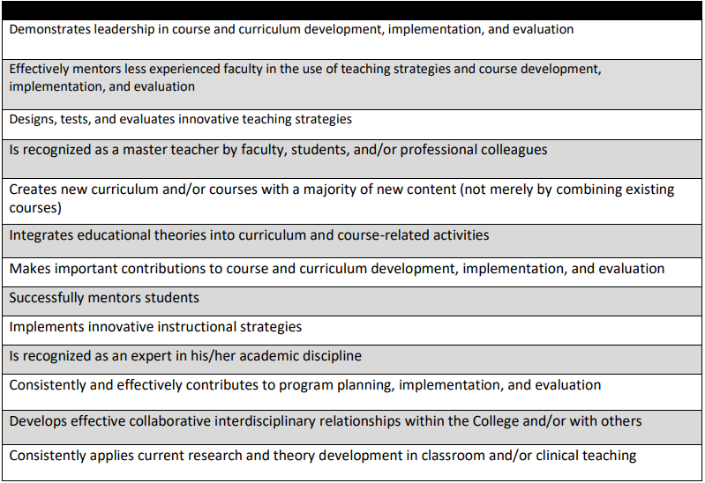
Teaching - Demonstrating Excellence or Significant Achievement
Examples (not an exhaustive list) of accomplishments in teaching.
May be used to demonstrate excellence or significant achievement.
Narrative should explicitly describe how these (and any other) accomplishments contribute to demonstrating either excellence or significant achievement.

Slide 5
Teaching Narrative
Use examples from the list in the Teaching folder (or other teaching-related accomplishments) to guide your teaching narrative.
Use headings within your narrative to depict what’s coming in that part of the narrative.
The percent of your time dedicated to teaching should be stated in your teaching narrative.
Percent effort is related to your assigned workload.
The larger your percent effort/workload dedicated to teaching, the more accomplishments you should have toward demonstrating excellence (or significant achievement).

Slide 6
Teaching Narrative
Example:
Demonstrates leadership in course and curriculum development, implementation, and evaluation. (this would be the heading in the narrative)
For example, did you lead colleagues in completely redesigning curriculum, courses, and/or evaluation?
You want to give measurable outcomes.
Remember to communicate the “so what?” factor – the impact behind your accomplishments.
Provide evidence of impact, not solely that new curriculum was developed.
With your guidance, colleagues developed new courses, or evaluation techniques/strategies (?)
Resulted in a more dynamic program?
Resulted in better student outcomes?
Resulted in program elements unique for the profession?
Resulted in program elements unique from similar programs in the state/region?

Slide 7
Teaching Narrative
Example:
Effectively mentors less experienced faculty in the use of teaching strategies and course development, implementation, and evaluation. (this would be the heading in the narrative)
Explain how you did this.
Give objectives, document time line.
You want to demonstrate how this affected the faculty being mentored – the impact.
Address the “so what?” factor.
For example, what did the mentee accomplish due to your mentoring?

Slide 8
Teaching Narrative
Example:
Designs, tests, and evaluates innovative teaching strategies (e.g., multi-media program, problem-based learning). (this would be the heading in the narrative)
Again, give outcomes (evidence, impact, “so what?” factor) to show that your accomplishments had a measurable impact.
Did your contributions change anything?
Communicate in your narrative how your contributions made a difference.

Slide 9
Teaching Narrative
Example:
Is recognized as a master teacher by faculty, students, and/or professional colleagues. (this would be the heading in the narrative)
Recognized as a master teacher by:
Improved scores on national exams?
Excellent student evaluations?
Less attrition?
Teaching awards (nominations for awards)?
Peer evaluations?
Include tables displaying student evaluations for individual courses and/or peer evaluations.

Slide 10
Teaching Narrative
Example:
Creates new curriculum and/or courses with a majority of new content (not merely by combining existing courses). (this would be the heading in the narrative)
List what course(s) with dates created.
Why were new courses developed (etc.)?
What was the impact of creating those new courses?
Created courses that filled gaps in program curriculum?
Created courses that are not offered in similar programs in the state?
Created courses that enhanced the student experience?
What is the evidence?

Slide 11
Teaching Narrative
Example:
Integrates educational theories into curriculum and course-related activities. (this would be the heading in the narrative)
List new theories utilized and describe how they were applied.
Reference/cite sources to support use of theory.
What was the impact of the integration of educational theories into the curriculum?
Provided more informed decisions around the design, development and delivery of learning(?).
Evidence demonstrating this impact?

Slide 12
Teaching Narrative
Example:
Makes important contributions to course and curriculum development, implementation, and evaluation. (this would be the heading in the narrative)
Describe the contributions (extent of contributions) to courses developed and/or implemented and include time spent and dates.
What was the impact of the contribution (“so what?” factor)?
Led to improved evaluation of courses?
Evidence?
Included elements that have not been taught before?
What was the benefit?
Developed online components?
What was the benefit/impact?

Slide 13
Teaching Narrative
Example:
Successfully mentors students. (this would be the heading in the narrative)
As with faculty mentoring, give objectives, document time line.
You want to demonstrate how this affected the students being mentored.
Abstract submissions (?)
Poster presentations (?)
Improved student performance (?)
Successfully meet program milestones (?)
Etc.

Slide 14
Teaching Narrative
Example:
Implements innovative instructional strategies. (this would be the heading in the narrative)
Such as multi-media program, problem-based learning, etc.
Answer the why behind the implementation of the innovative instructional strategies.
What was impact resulting from the implementation of the innovative instructional strategies?

Slide 15
Teaching Narrative
Example:
Consistently and effectively contributes to program planning, implementation, and evaluation. (this would be the heading in the narrative)
Give examples such as consulting, invited to give lectures and/or presentations, etc.
Any lecture/presentation evaluation/feedback?
If invited to give a lecture/presentation, bring your own evaluation forms for the audience to complete (in case one is not provided for you).
Include evaluation data in your narrative.
Consistently implies “more than once”, so give dates (and locations, etc.).

Slide 16
Teaching Narrative
Example:
Develops effective collaborative interdisciplinary relationships within the College and/or with others. (this would be the heading in the narrative)
Give examples such as working with IPE, 12th Street or other venues.
What made the collaborative relationships effective?
Describe the “so what?” factor behind the development of the collaborative relationships.

Slide 17
Teaching Narrative
Example:
Consistently applies current research and theory development in classroom and/or clinical teaching. (this would be the heading in the narrative)
Describe the research and theory development and how they were applied.
Reference/cite sources to support use/application.
What was the impact of the use/application in classroom and/or clinical teaching?
Provided exposure to innovative profession-specific practices (?).
Evidence demonstrating impact?
Again, consistently implies “more than once”, so be sure to address this aspect of the accomplishment.

Slide 18
Collegiality in P & T (specific to guidance in the 2017 CHP P&T Guidelines)
Defined as collaborating with other members of the faculty and administration;
speaking in a professional and respectful manner toward others;
agreeing to serve and performing tasks for the good of the group;
following through on professional tasks, meeting deadlines, and carrying out all relevant responsibilities;
respecting the decision-making processes of the unit; communicating with others respectfully;
and relating to others in ways that are constructive, supportive, and professional.

Slide 19
Collegiality in P & T (specific to guidance in the 2017 CHP P&T Guidelines)
Demonstrating collegiality is important in all three areas: teaching, scholarship, and service.
Evidence of collegiality for the purposes of promotion and tenure may be demonstrated in numerous ways:
annual performance evaluations, peer and student evaluations, testimonials and letters of support, offers to lead committees, task groups, etc.

Slide 20
Teaching Folder
NOTE:
The list of examples of teaching accomplishments is not all-inclusive.
Faculty may consider other activities to satisfy the requirements for proof of excellence or significant achievement.
Communicate with your Program Director, Department Chair, and Colleagues for guidance.

Slide 21
CHP P&T Database Teaching Folder Contents
Your teaching folder should include:
Teaching Narrative
Required as described in slides.
Letters of support speaking specifically to teaching
Not required, but helpful.
Regarding 2017 CHP P&T Guidelines, these letters could also address collegiality.
These letters are separate from/in addition to the letters in the LETTERS OF RECOMMENDATION/SUPPORT section.
Other teaching support materials
Examples of evidence of accomplishments.
Should be discussed and cited in the narrative.

Slide 22
P & T Guidelines-Teaching
How many possibilities do you see?

