Slide 1
College of Health Professions Promotion and/or Tenure Portfolio Preparation Workshop

Slide 2
Overview of CHP Promotion & Tenure Processes
Pre-Promotion and/or Pre-Tenure Review Process
Notification & Review Process
Accessing the CHP P&T Database
CHP P&T Database Login Page
User Guide to Start Your Packet
Approval Steps/Flow for CHP P&T Review Process within the CHP P&T Database
Approval Steps/Flow for CHP P&T Review Process
General Tips Regarding Portfolio/Packet Preparation

Slide 3
Pre-Promotion and/or Pre-Tenure Review
Before or during the third appointment year in the college, and with the recommendation of the department chairperson/program director, a faculty member may submit a portfolio for CHP Promotion and Tenure Committee review. The pre-promotion and/or pre-tenure review is the faculty member’s opportunity to receive feedback from the CHP P&T committee about preparation of credentials (i.e., portfolio) and progress toward promotion and/or tenure.

Slide 4
Pre-Promotion and/or Pre-Tenure Review
The portfolio must be submitted to the CHP P&T committee chairperson by January 15 or the next work day if January 15 is not a work day.
Pre-tenure/pre-promotion reviews will occur only in the spring semester. A faculty member may submit up to two requests for a pre-tenure review during the probationary period.
The CHP P&T committee shall provide the faculty member and department chairperson with a written, nonbinding, critique of his/her pre-tenure and/or pre-promotion portfolio by the last work day in February.

Slide 5
Notification & Review Process
A department chairperson considering recommendation of a faculty member for promotion or tenure shall require the faculty member to submit his/her portfolio to the department chairperson by the first Tuesday in July. If the first Tuesday in July is an official State of Arkansas holiday, i.e., July 4, the portfolio will be submitted by the end of the next day, i.e., July 5.
The department chairperson shall initiate the promotion and/or tenure process. The department chairperson shall provide written notice to each candidate of the action taken and forward the portfolios of the candidates being recommended to the CHP P&T committee by the first Tuesday in September.

Slide 6
Notification & Review Process
Recommendations of the CHP P&T committee will be based on a majority vote of all eligible voting members. In the event of a tie vote, the application for appointment, promotion, or tenure will not be recommended, and the P&T committee shall provide a letter of justification for the decision to the candidate, department chairperson, and the dean.
The P&T committee shall provide written notice to each candidate and the candidate’s department chairperson of the review of evidence, action taken, and forward the portfolios of those candidates being recommended to the dean by the first Tuesday in November.
The dean shall provide written notice to each candidate and the candidate’s department chairperson of the action taken and forward the portfolios of those candidates being recommended to the chancellor by January 15.

Slide 7
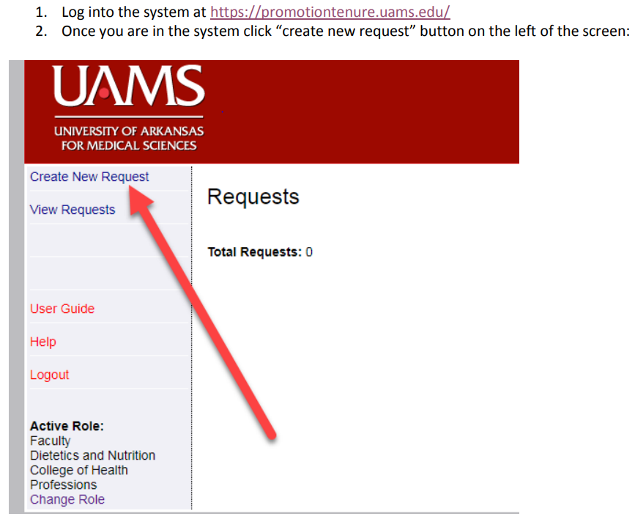
Accessing the CHP P&T Database
If you hit any road blocks along the way with getting access to the CHP P&T Database, please contact:
Fatera S Herd in the UAMS Faculty Center (FSHerd@uams.edu)
or
The CHP P&T Committee Chair

Slide 8
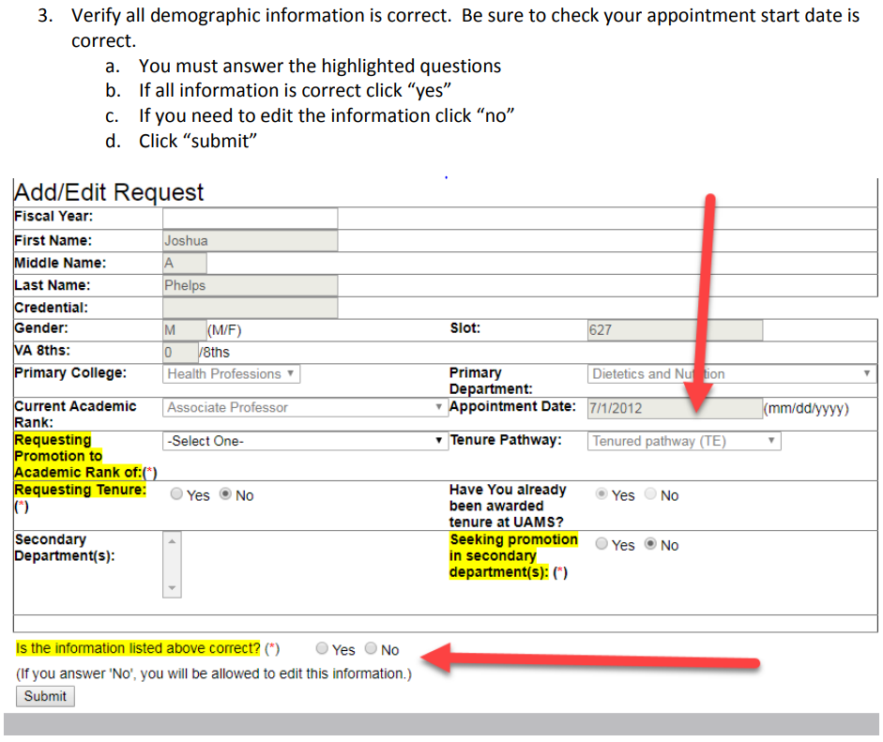
Accessing the CHP P&T Database

Slide 9
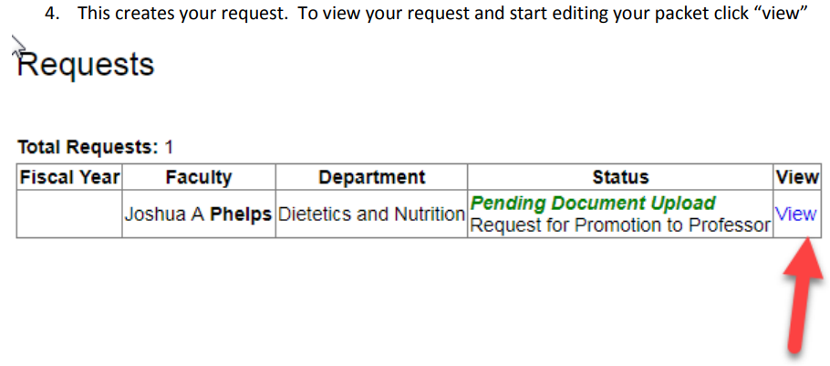
Accessing the CHP P&T Database

Slide 10
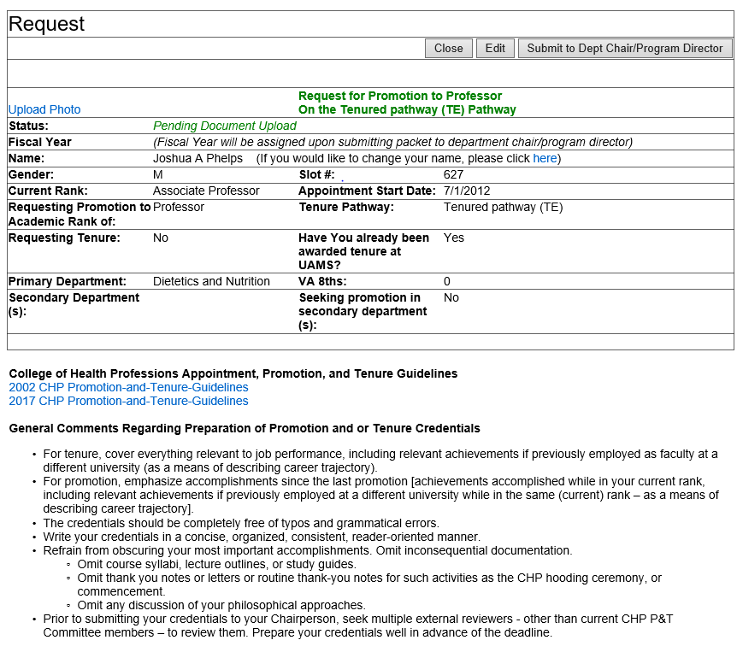
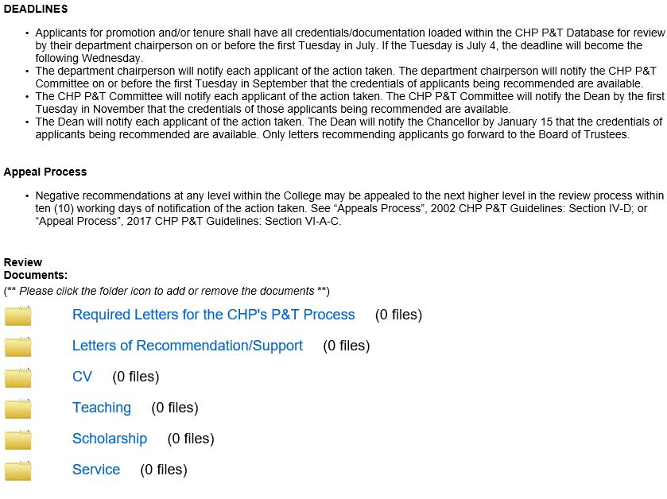
Accessing the CHP P&T Database
5. You have now created your request. It should look like this and you can begin to build your packet.
(Toward the top of the webpage)
(Toward the bottom the webpage)

Slide 11
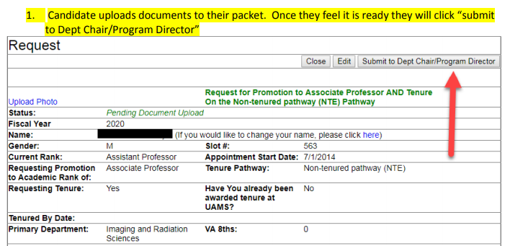
Approval Steps/Flow for CHP P&T Review Process
within the CHP P&T Database

Slide 12
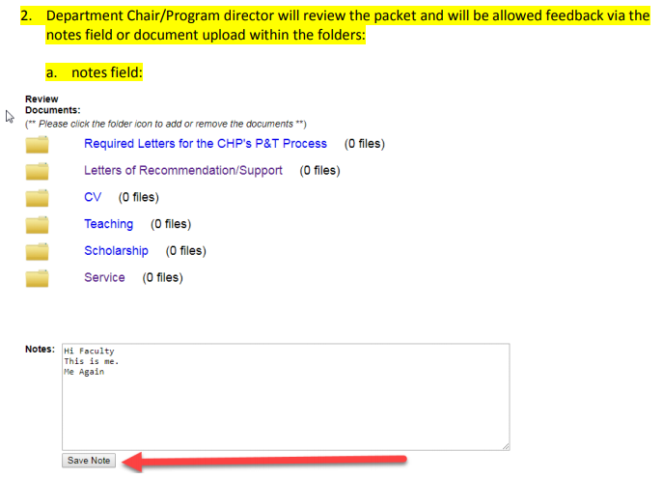
Approval Steps/Flow for CHP P&T Review Process
within the CHP P&T Database

Slide 13
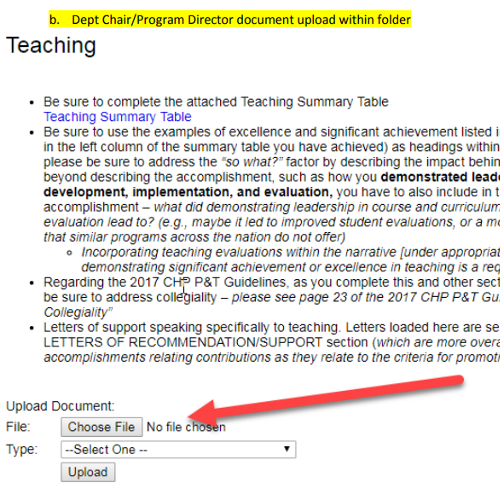
Approval Steps/Flow for CHP P&T Review Process
within the CHP P&T Database

Slide 14
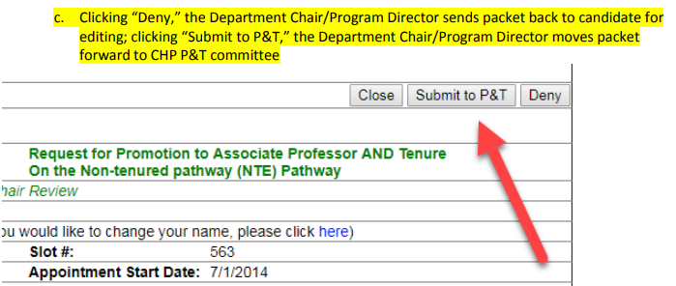
Approval Steps/Flow for CHP P&T Review Process
within the CHP P&T Database

Slide 15
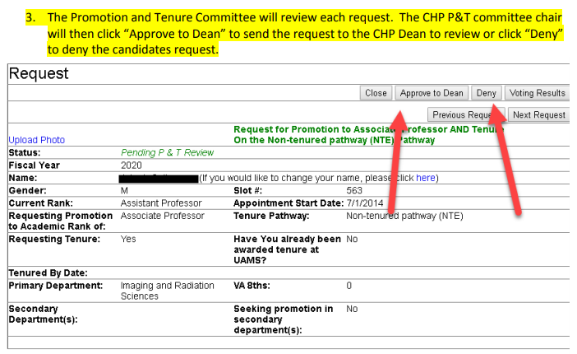
Approval Steps/Flow for CHP P&T Review Process
within the CHP P&T Database

Slide 16
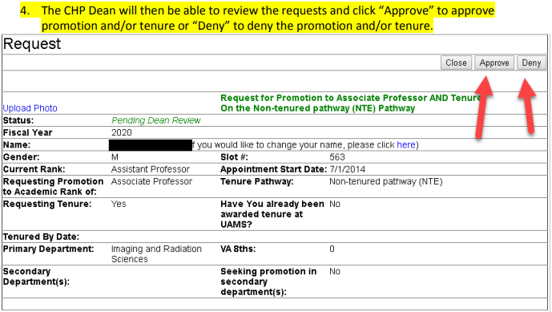
Approval Steps/Flow for CHP P&T Review Process
within the CHP P&T Database

Slide 17
Approval Steps/Flow for CHP P&T Review Process
within the CHP P&T Database

Slide 18
General Tips Regarding Portfolio/Packet Preparation
Letter from the applicant (directed to your Department Chair or Program Director)
Maximum of two pages, single spaced
Specifically indicate which guidelines you are using
2002 or 2017 – be sure you are using the appropriate guidelines
State whether you are applying for promotion or tenure, or both
State the ranks from and to which you wish to be promoted
Make clear you meet specific minimum requirements for the academic rank and track, for which you are applying.
See page 12 of the 2002 CHP P&T Guidelines; page 17 of the 2017 CHP P&T Guidelines
Summarize your credentials, including only pertinent information
In order of strength, explain the three areas of evaluation for promotion and tenure: Teaching, Service, and Scholarship
Pay attention to and communicate workload/percent effort when summarizing credentials
Regarding the 2017 CHP P&T Guidelines, be sure to address collegiality
see page 23 of the 2017 CHP P&T Guidelines for “Indicators and Evidence of Collegiality”

Slide 19
General Tips Regarding Portfolio/Packet Preparation
Letter from the Department Chair or Program Director (directed to the CHP P&T Committee Chair)
If a Department Chair or Program Director (without a Department Chair) is submitting documentation for consideration for promotion and/or tenure, the Dean will submit a letter in support of that faculty member
Specifically indicate which P&T guidelines were used
State whether the applicant is applying for promotion or tenure, or both
State the ranks from and to which the candidate wishes to be promoted
Make clear the candidate met specific minimum requirements for the academic rank and track, for which she/he is applying.
Summarize his/her credentials, including only pertinent information
In order of strength, explain the three areas of evaluation for promotion and tenure: Teaching, Service, and Scholarship
Pay attention to and communicate workload/percent effort when summarizing credentials
Regarding the 2017 CHP P&T Guidelines, be sure to address collegiality

Slide 20
General Tips Regarding Portfolio/Packet Preparation
Letters of Recommendation/Support
A minimum of three (3) letters of recommendation/support are required.
References should be selective and include persons who can speak directly to the faculty member’s contributions as they relate to the criteria for promotion and/or tenure.
Authors should be able to comment on quality and consistency of performance in at least two (2) areas of evaluation (Teaching, Scholarship, Service), and, if appropriate, Collegiality.
These are overarching letters speaking to your accomplishments related to contributions that meet criteria for promotion and/or tenure. These individuals hold a rank that is equal to or higher than that sought by the applicant.

Slide 21
General Tips Regarding Portfolio/Packet Preparation
Letters of Recommendation/Support
Communicate with your Department Chair and/or Program Director to determine appropriate references
Seek references from outside your Program/Department to review your packet against CHP P&T Guidelines and write a letter
It is inappropriate for current CHP P&T Committee members, other than the candidate’s Department Chair/Program Director, to write letters of support

Slide 22
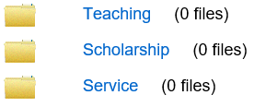
General Tips Regarding Portfolio/Packet Preparation
Writing Narratives for Each of the Bucket Folders
Be sure to explicitly describe how your accomplishments contributed to demonstrating either excellence or significant achievement.
if teaching is an area where you are indicating you have achieved excellence, your narrative should be directed toward describing how your accomplishments contributed to demonstrating excellence;
if teaching is an area where you are indicating you have achieved significant achievement, your narrative should be directed toward describing how your accomplishments contributed to demonstrating significant achievement.
Do not mix the two (excellence and significant achievement)

Slide 23
General Tips Regarding Portfolio/Packet Preparation
Writing Narratives
This is a time to brag – do not be humble
Tell the CHP P&T Committee how you have achieved excellence or significant achievement – tell your story
Provide evidence beyond stating the accomplishment
Go beyond the description
Get to the “so what?” factor
Where is the evidence to support impact of your accomplishment?
Do not make the P&T Committee members search for it
Packets Will Be Denied If Evidence Is Absent Or Not Clear

Slide 24
Please see the other PowerPoint presentations for specific guidance on preparing materials for your Teaching, Scholarship, and Service folders. Please contact CHP P&T Committee members about questions or additional information.

